Slide 1
Memory

Slide 2
Memory
Memory: Part of the computer where programs and data are stored
Consist of a number of cells (or locations), each of which can store a piece of information
Each cell has a number, called its address, by which programs can refer to it
If a memory has n cells, they will have addresses 0 to n − 1
All cells in a memory contain the same number of bits

Slide 3
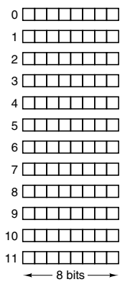
Memory Example

Slide 4
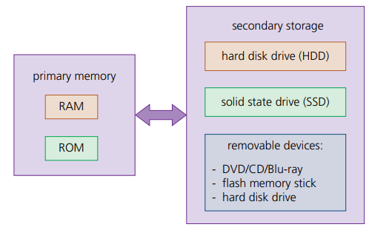
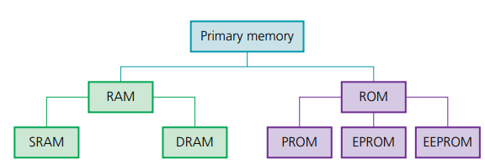
Memory Classification

Slide 5
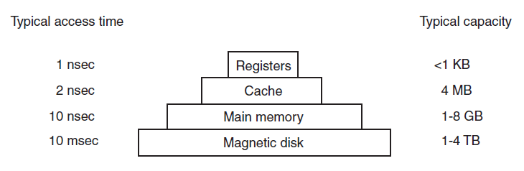
Memory Hierarchy
Fastest access, Most expensive
Slowest access, Least costly

Slide 6
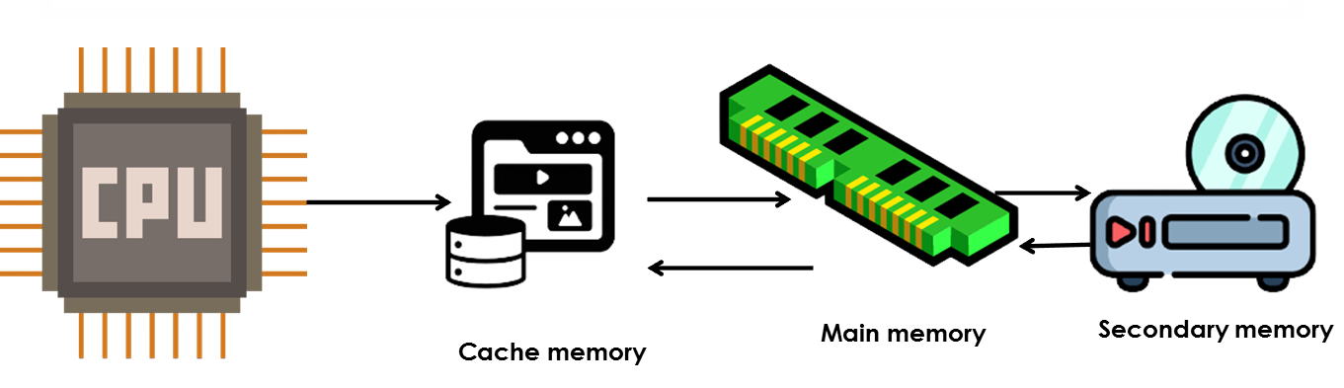
Cache Memory Placement

Slide 7
Technologies used in Memory Design
Types of memories
Random Access Memory (RAM): Memory from where data can be read and where data can be written – Volatile
Static RAM (SRAM)
Dynamic RAM (DRAM)
Read Only Memory (ROM): Memory from where data can be read, but not where data can be written
Useful for booting up, fixed data

Slide 8
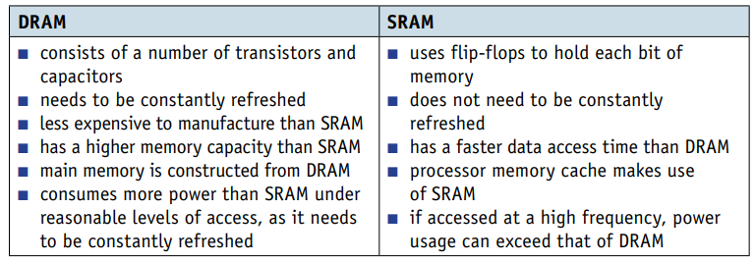
DRAM versus SRAM
Used as cache memory

Slide 9
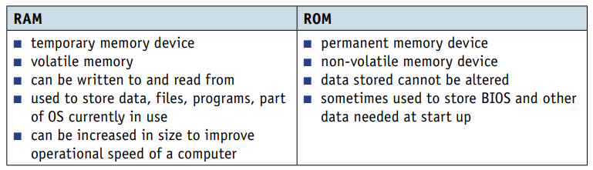
RAM versus ROM

Slide 10
PROM
PROM (Programmable ROM) allows companies to write to the ROM chip once, not at the time of chip manufacturing
Example: A washing machine manufacturer can buy ROM chips and write its instructions on the chip

Slide 11
Auxiliary Storage
Auxiliary storage, also known as secondary memory or external storage, refers to the non-volatile storage devices that retain information even when the power supply is disconnected
Examples: HDD, SSD, Flash memory, Optical storage

Slide 12
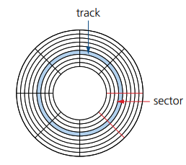
Hard Disk Drive (HDD)
Mechanical storage devices
Use magnetic material to store data
High capacity, low cost
These days replaced by SSD

Slide 13
Flash Memory
Non-volatile memory
Retains data even when there is no power supply
Used in Solid State Drives (SSD), USB drives, memory cards
Low power consumption and durable
Other varieties: NAND flash memory or NOR flash memory

Slide 14
Solid State Drive (SSD)
Use NAND flash memory
Faster, more durable

Slide 15
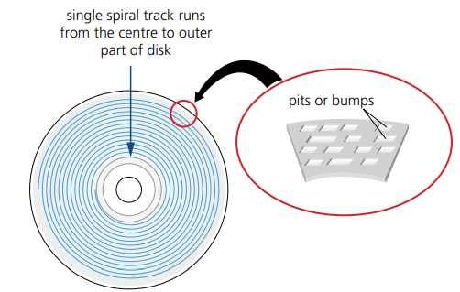
Optical Storage
CD-ROM, DVD, Bluray disks
Magnetic disk contains information
Used more for music, movies, etc

Slide 16
Memory Interleaving
Memory interleaving: Improve memory access performance by distributing data across multiple memory modules or banks or interleaves
Example: If we have two memory modules, the memory space might be divided into two interleaves: Interleave 0 and Interleave 1
Uses round robin algorithm
Parallel memory access possible
More useful in multi-core processors

Slide 17







Memory Interleaving Example
Suppose we decide to use 4 interleaved memory modules
Module 0 will contain memory addresses 0, 4, 8, 12, 16, …
Module 1 will contain memory addresses 1, 5, 9, 13, 17, …
Module 2 will contain memory addresses 2, 6, 10, 14, 18, …
Module 3 will contain memory addresses 3, 7, 11, 15, 19, …
Advantage: The CPU(s) can read memory modules one after the other quickly to access data. For example, suppose an instruction needs data from memory locations 2 to 9. The CPU can quickly go to memory module 2, then to 3, then to 1, then to 2 again, etc.

Slide 18
Virtual Memory and Paging

Slide 19
Machine Language Instructions in a Process
Example of Process P1:
Address 0: 0011 0000 0000 0000
Address 1: 0010 0010 0000 0110
Address 2: 0110 0100 0100 0000
Address 3: 0000 0100 0000 0101
Address 4: 0001 0010 0110 0001
Address 5: 0000 1110 0000 0001
Address 6: 1111 0000 0010 0101
Example of Process P2:
Address 0: 1111 0000 0010 0101
Address 1: 1110 0010 0001 1110
Address 2: 1100 0101 0100 1100
Address 3: 1100 1000 0010 0001
Address 4: 0001 0010 0110 0001

Slide 20
Process Addresses and Memory Addresses
Memory address | Contents
0 | …
1 | …
2
3
4
5
6
7
8
9
10
11
12
13
14
15
16 | …
Memory has cells, numbered using addresses
Example:

Slide 21
Accommodating Multiple Processes in Memory
Memory address | Contents
0 | 0011 0000 0000 0000
1 | 0010 0010 0000 0110
2 | 0110 0100 0100 0000
3 | 0000 0100 0000 0101
4 | 0001 0010 0110 0001
5 | 0000 1110 0000 0001
6 | 1111 0000 0010 0101
7
8 | 1111 0000 0010 0101
9 | 1110 0010 0001 1110
10 | 1100 1000 0010 0001
11 | 0001 0010 0110 0001
12 | 0001 0010 0110 0001
13
14
15
16 | …
Process P1’s addresses and real memory’ addresses map one-to-one
But Process P2’s addresses 0 to 4 are mapped to real memory addresses 8 to 12
Process P1
Process P2

Slide 22
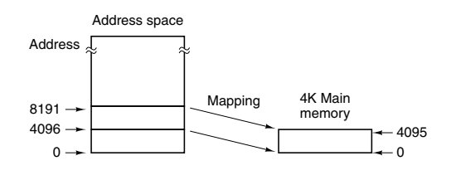
Virtual Memory: Need
Physical memory (RAM) size = 4096 bytes
Process needs ~1 MB
Solution: Bring only 4096 bytes of addressable memory (process data) into the physical memory at a time and keep the rest in secondary storage
Example:
0 to 4,095 OR
4,096 to 8,191 OR
8,192 to 12,287
etc
Addressable memory (Process memory)
Available memory (RAM)

Slide 23
Terminology
Process memory: Locations 0 to ~1 MB: Virtual address space
Real physical memory/RAM: Locations 0 to 4095 (Physical address space)
Page table or Page map table: Maps virtual address to physical address
Result: Virtual memory

Slide 24
Virtual Memory: Modernization
Now, physical memory is much more than 4096 bytes (e.g. 8/16 GB)
It is logically divided into page frames
Example: One page frame = 1 MB
So, number of page frames = 16 GB / 1 MB = (16 * 1024) / 1 = 16,384
Process memory is divided into virtual pages
Some virtual pages are loaded into page frames, and the remaining ones are in the secondary memory
See next slide

Slide 25
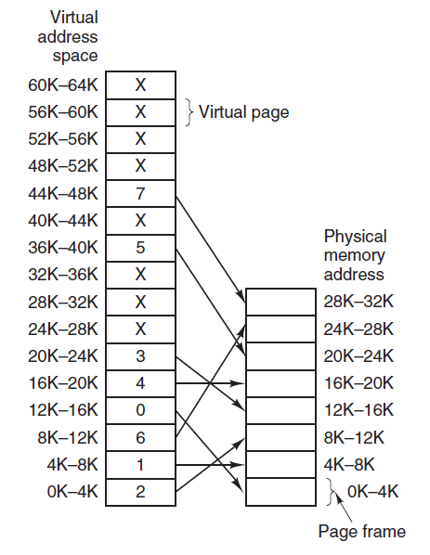
Page Mapping Table or Page Table
Virtual memory
Physical memory

Slide 26
Page Replacement – Basic idea
Page fault: Program refers to a virtual memory address that is not present in the physical/real main memory
Working set: Set of pages that a program is actively and heavily using
Page replacement policy: Decides how to handle page faults
Least Recently Used (LRU): Evicts the page least recently used
First In First Out (FIFO): Removes the first loaded page
Thrashing: A program that generates page faults frequently
Demand paging: Load pages only on demand, not in advance
Dirty bit: Tells the OS if the page contents were modified, so as to not lose the changes in the event of page replacement

Slide 27
Associative Memory
Associative memory: Also called Content-Addressable Memory (CAM)
Allows data to be retrieved based on its content rather than its specific memory address
Search keywords/patterns and stored with the data
We search for content or pattern, instead of providing memory address
Parallel search is possible: High performance
No need to sequentially look up memory addresses, so fast
Used in cache memory, network routers and applications where fast search is needed

